Slide 1
Venato Smart Shoe
Hardi Hamshin, Federica Carmen Maruccio, Mahyar Mehr, Rohit Nareshkumar, Phuong Huy Nguyen
Medical Engineering, Project Course
October 2021-January 2022

Slide 2
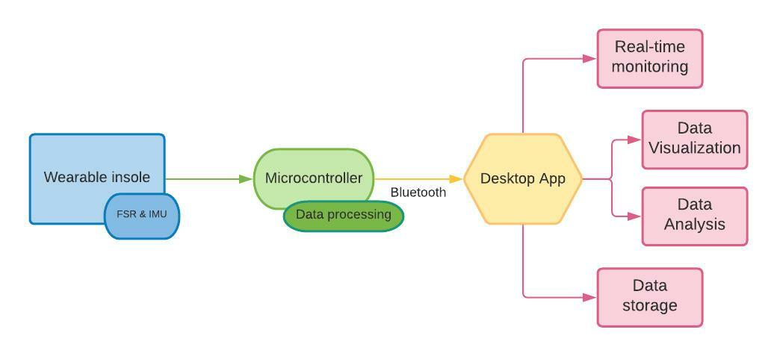
Recap: The plan
Block diagram

Slide 3
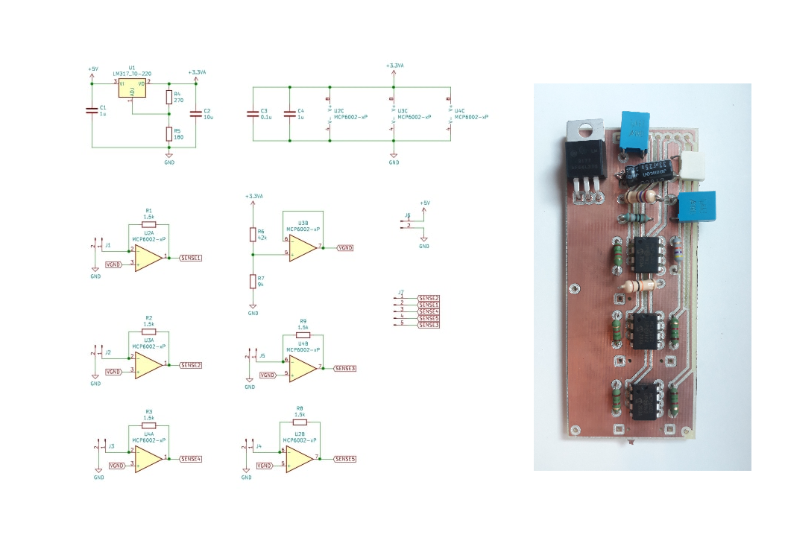
Recap: The tools
Op - amplifier circuit for FSR
Voltage regulator for low noise analog supply
9 axis IMU connect over I2C
2x soles connect over BLE to a Desktop / Mobile App

Slide 4
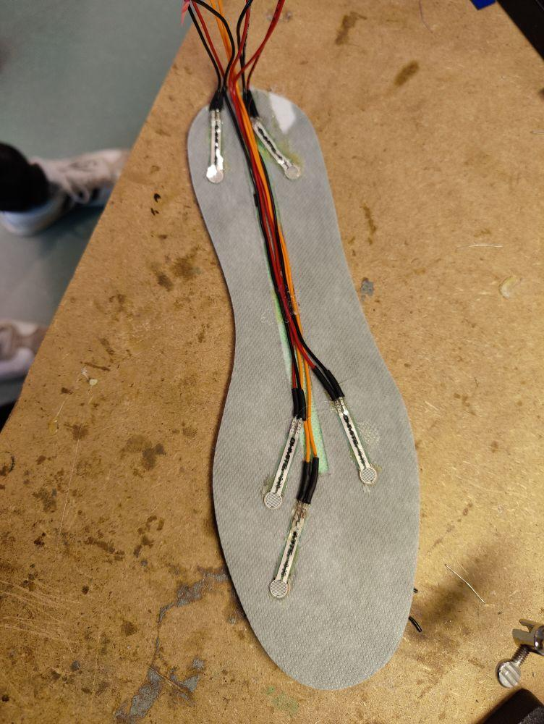
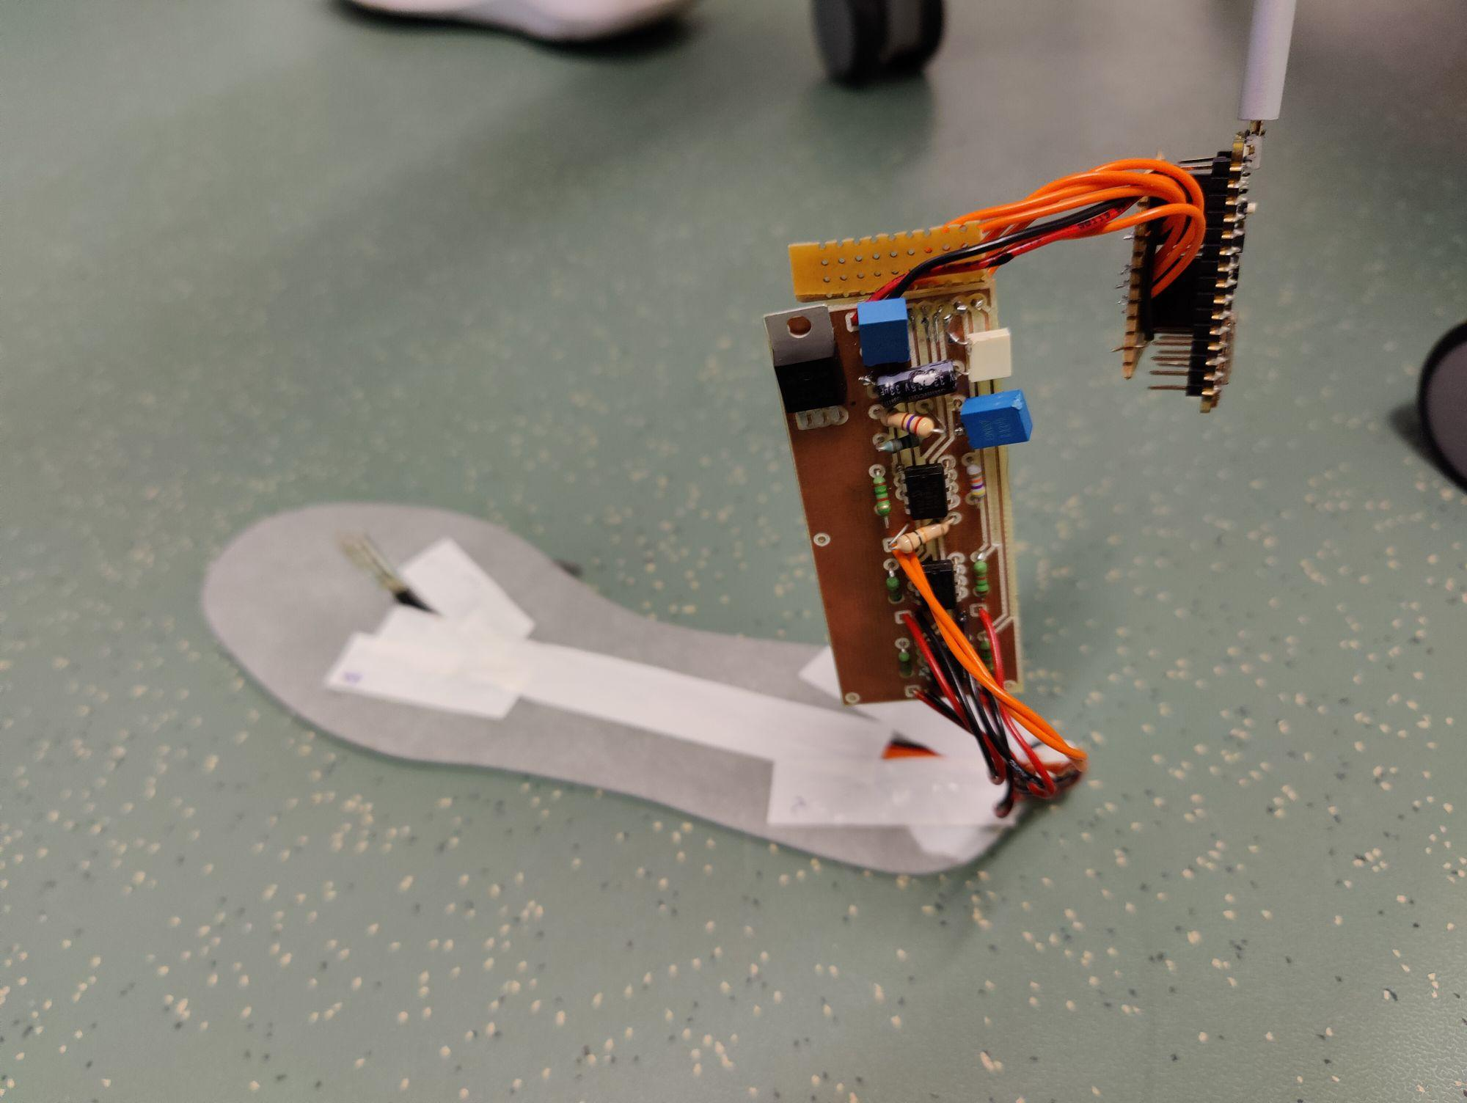
But what happened…?
Proto v1
Include 4x FSR (one broke during assembly)
Power and data only through USB
Dangling IMU, sole and tape!
Traces and connectors kept breaking
One of the tiny capacitors near the antenna sheared off

Slide 5
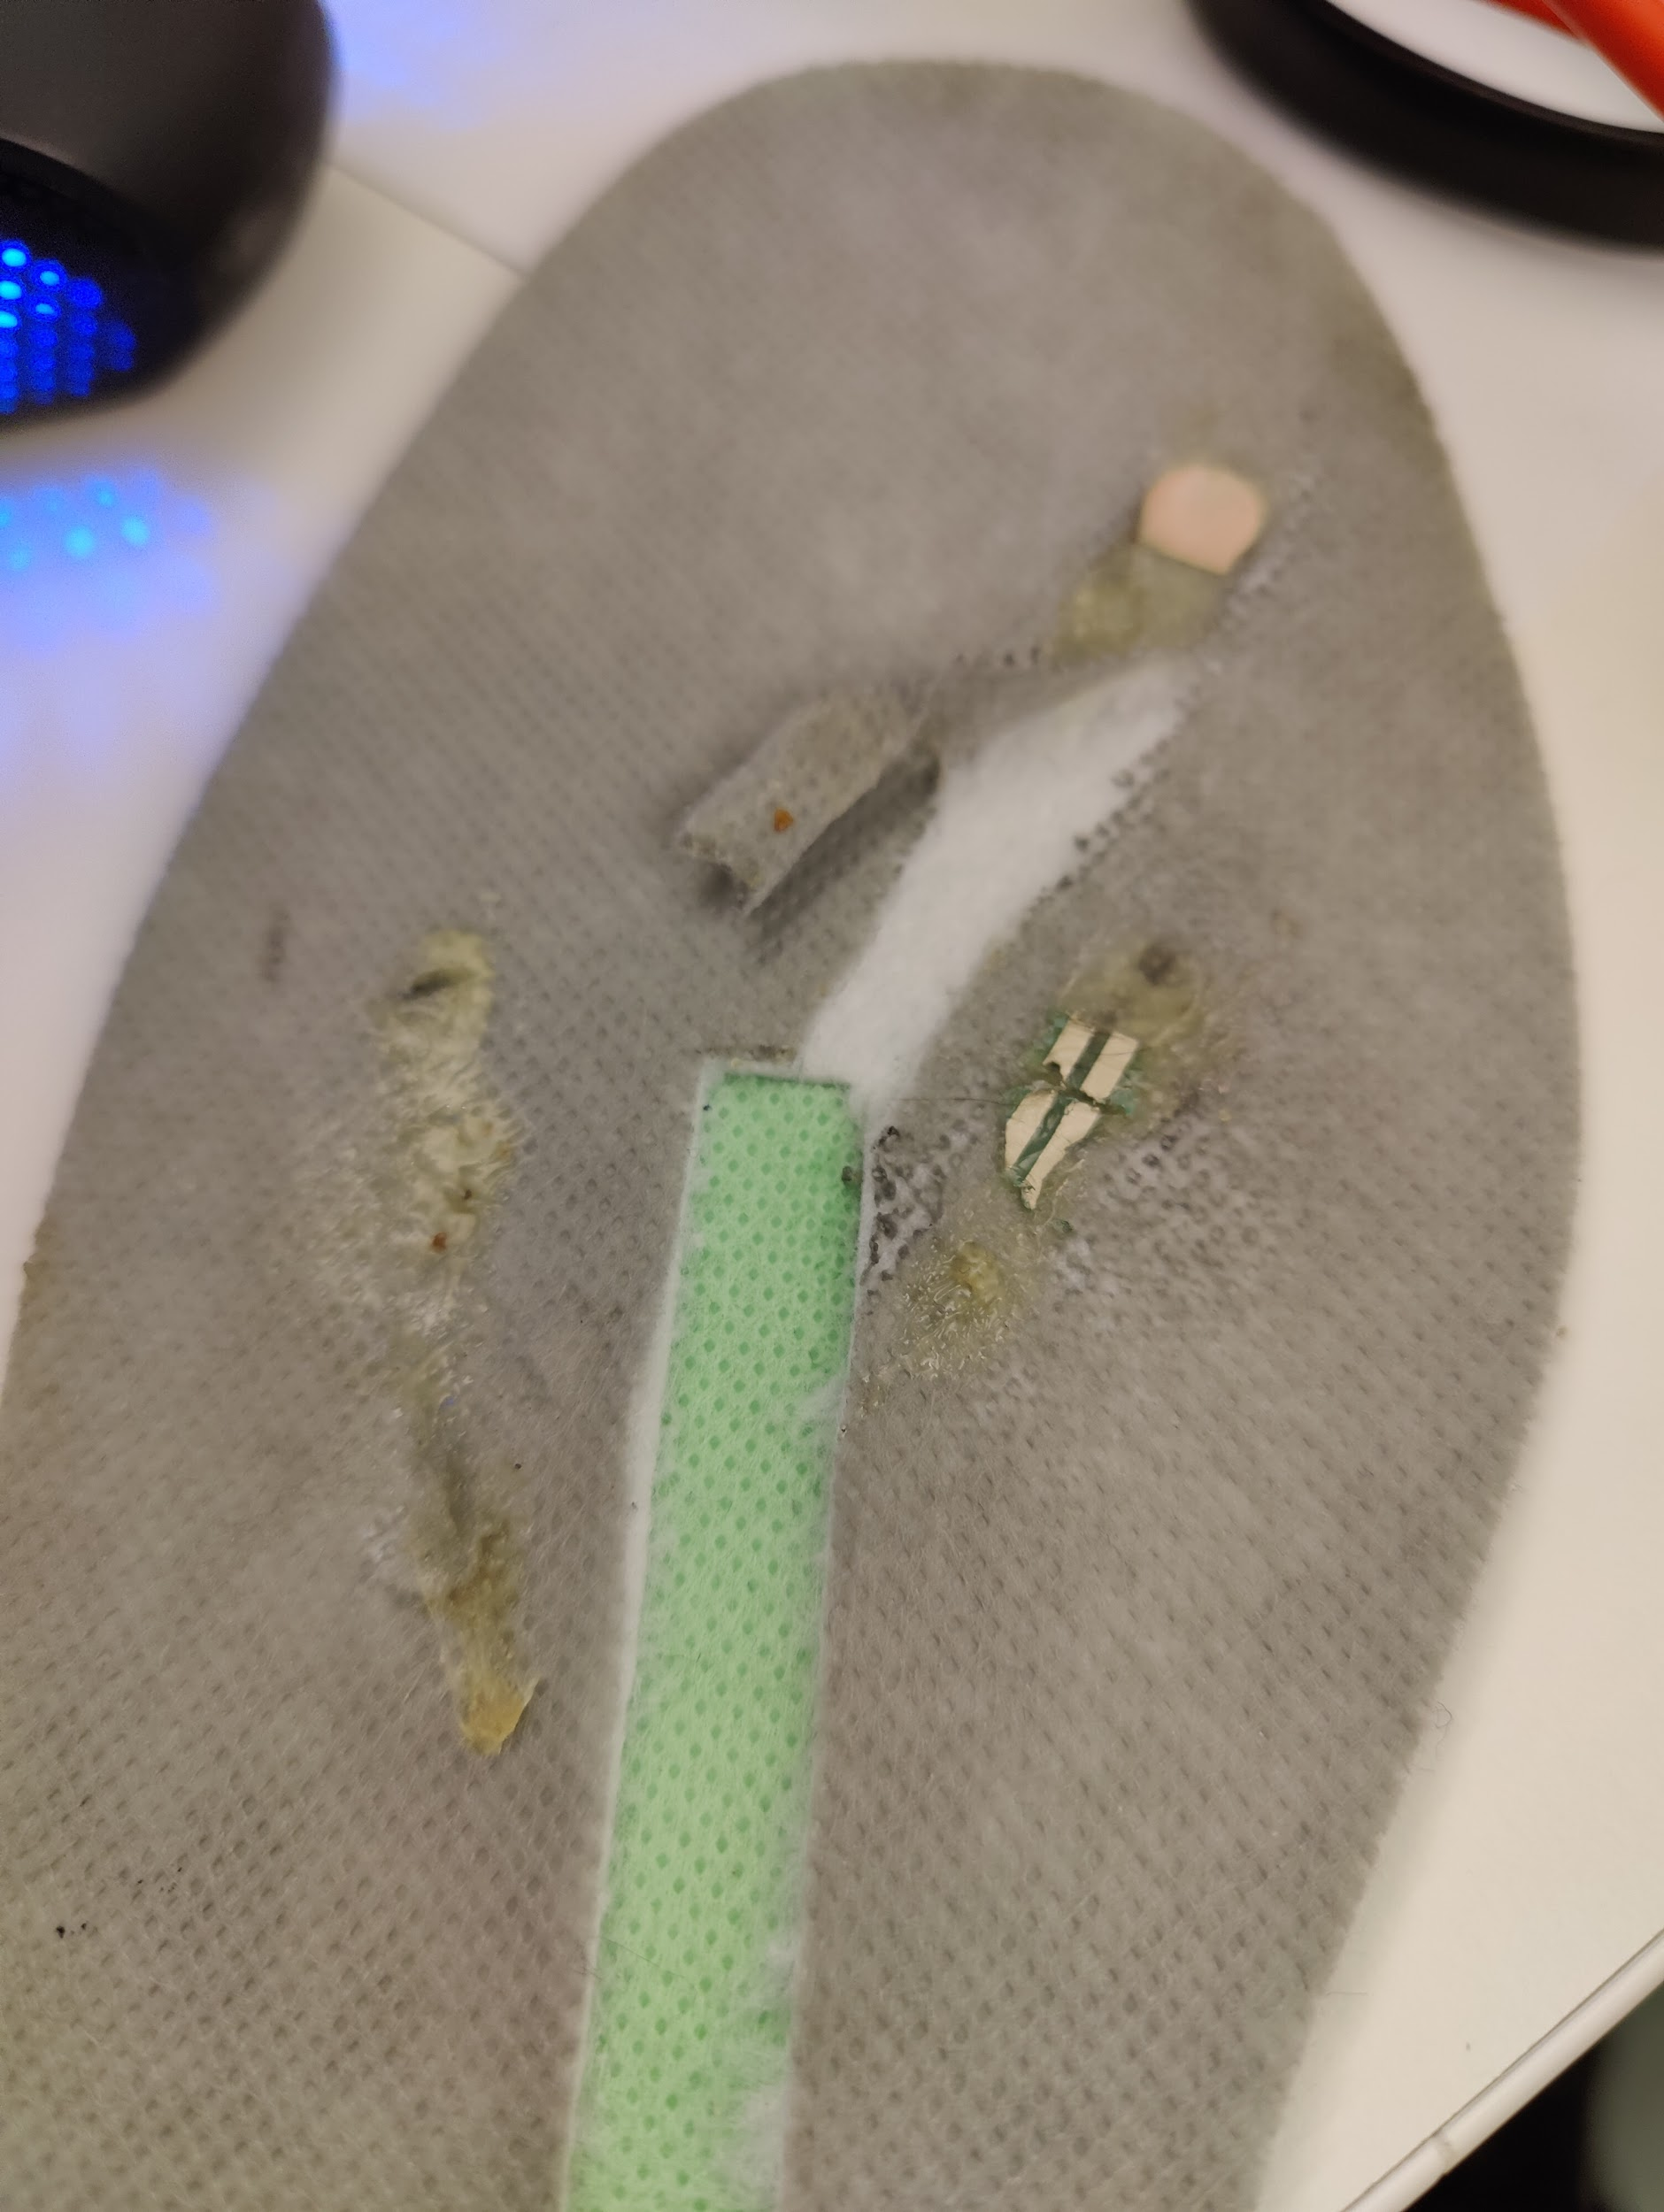
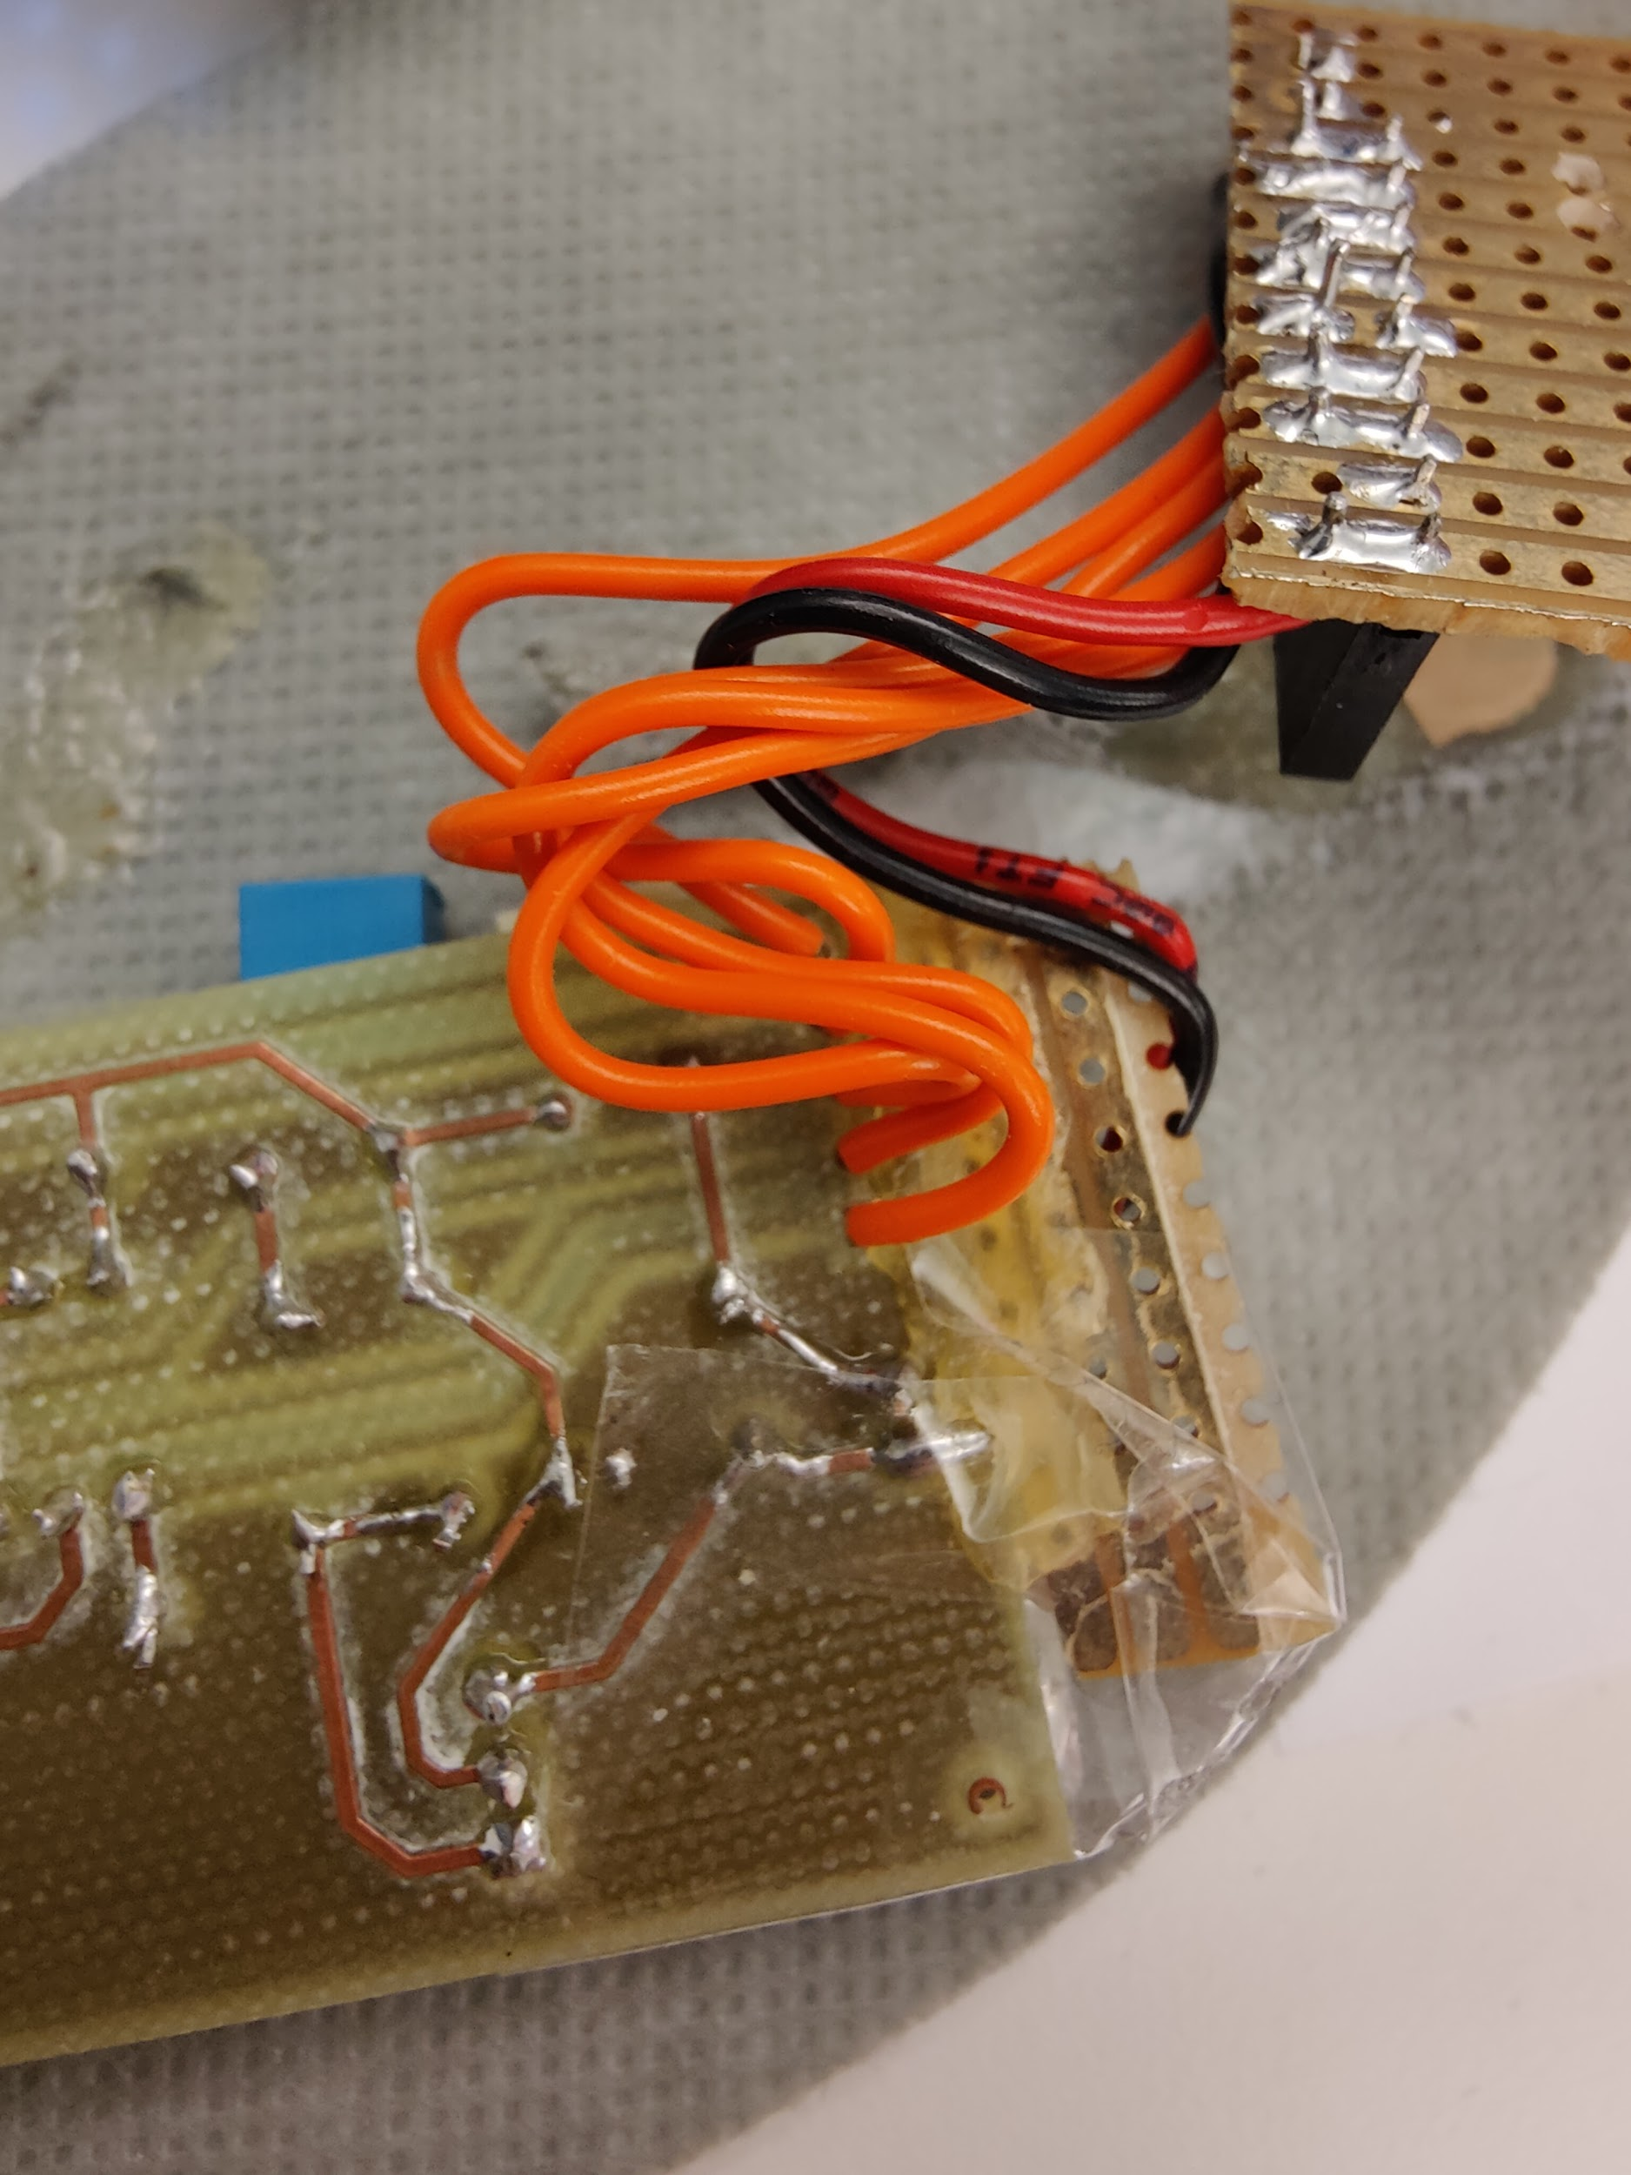
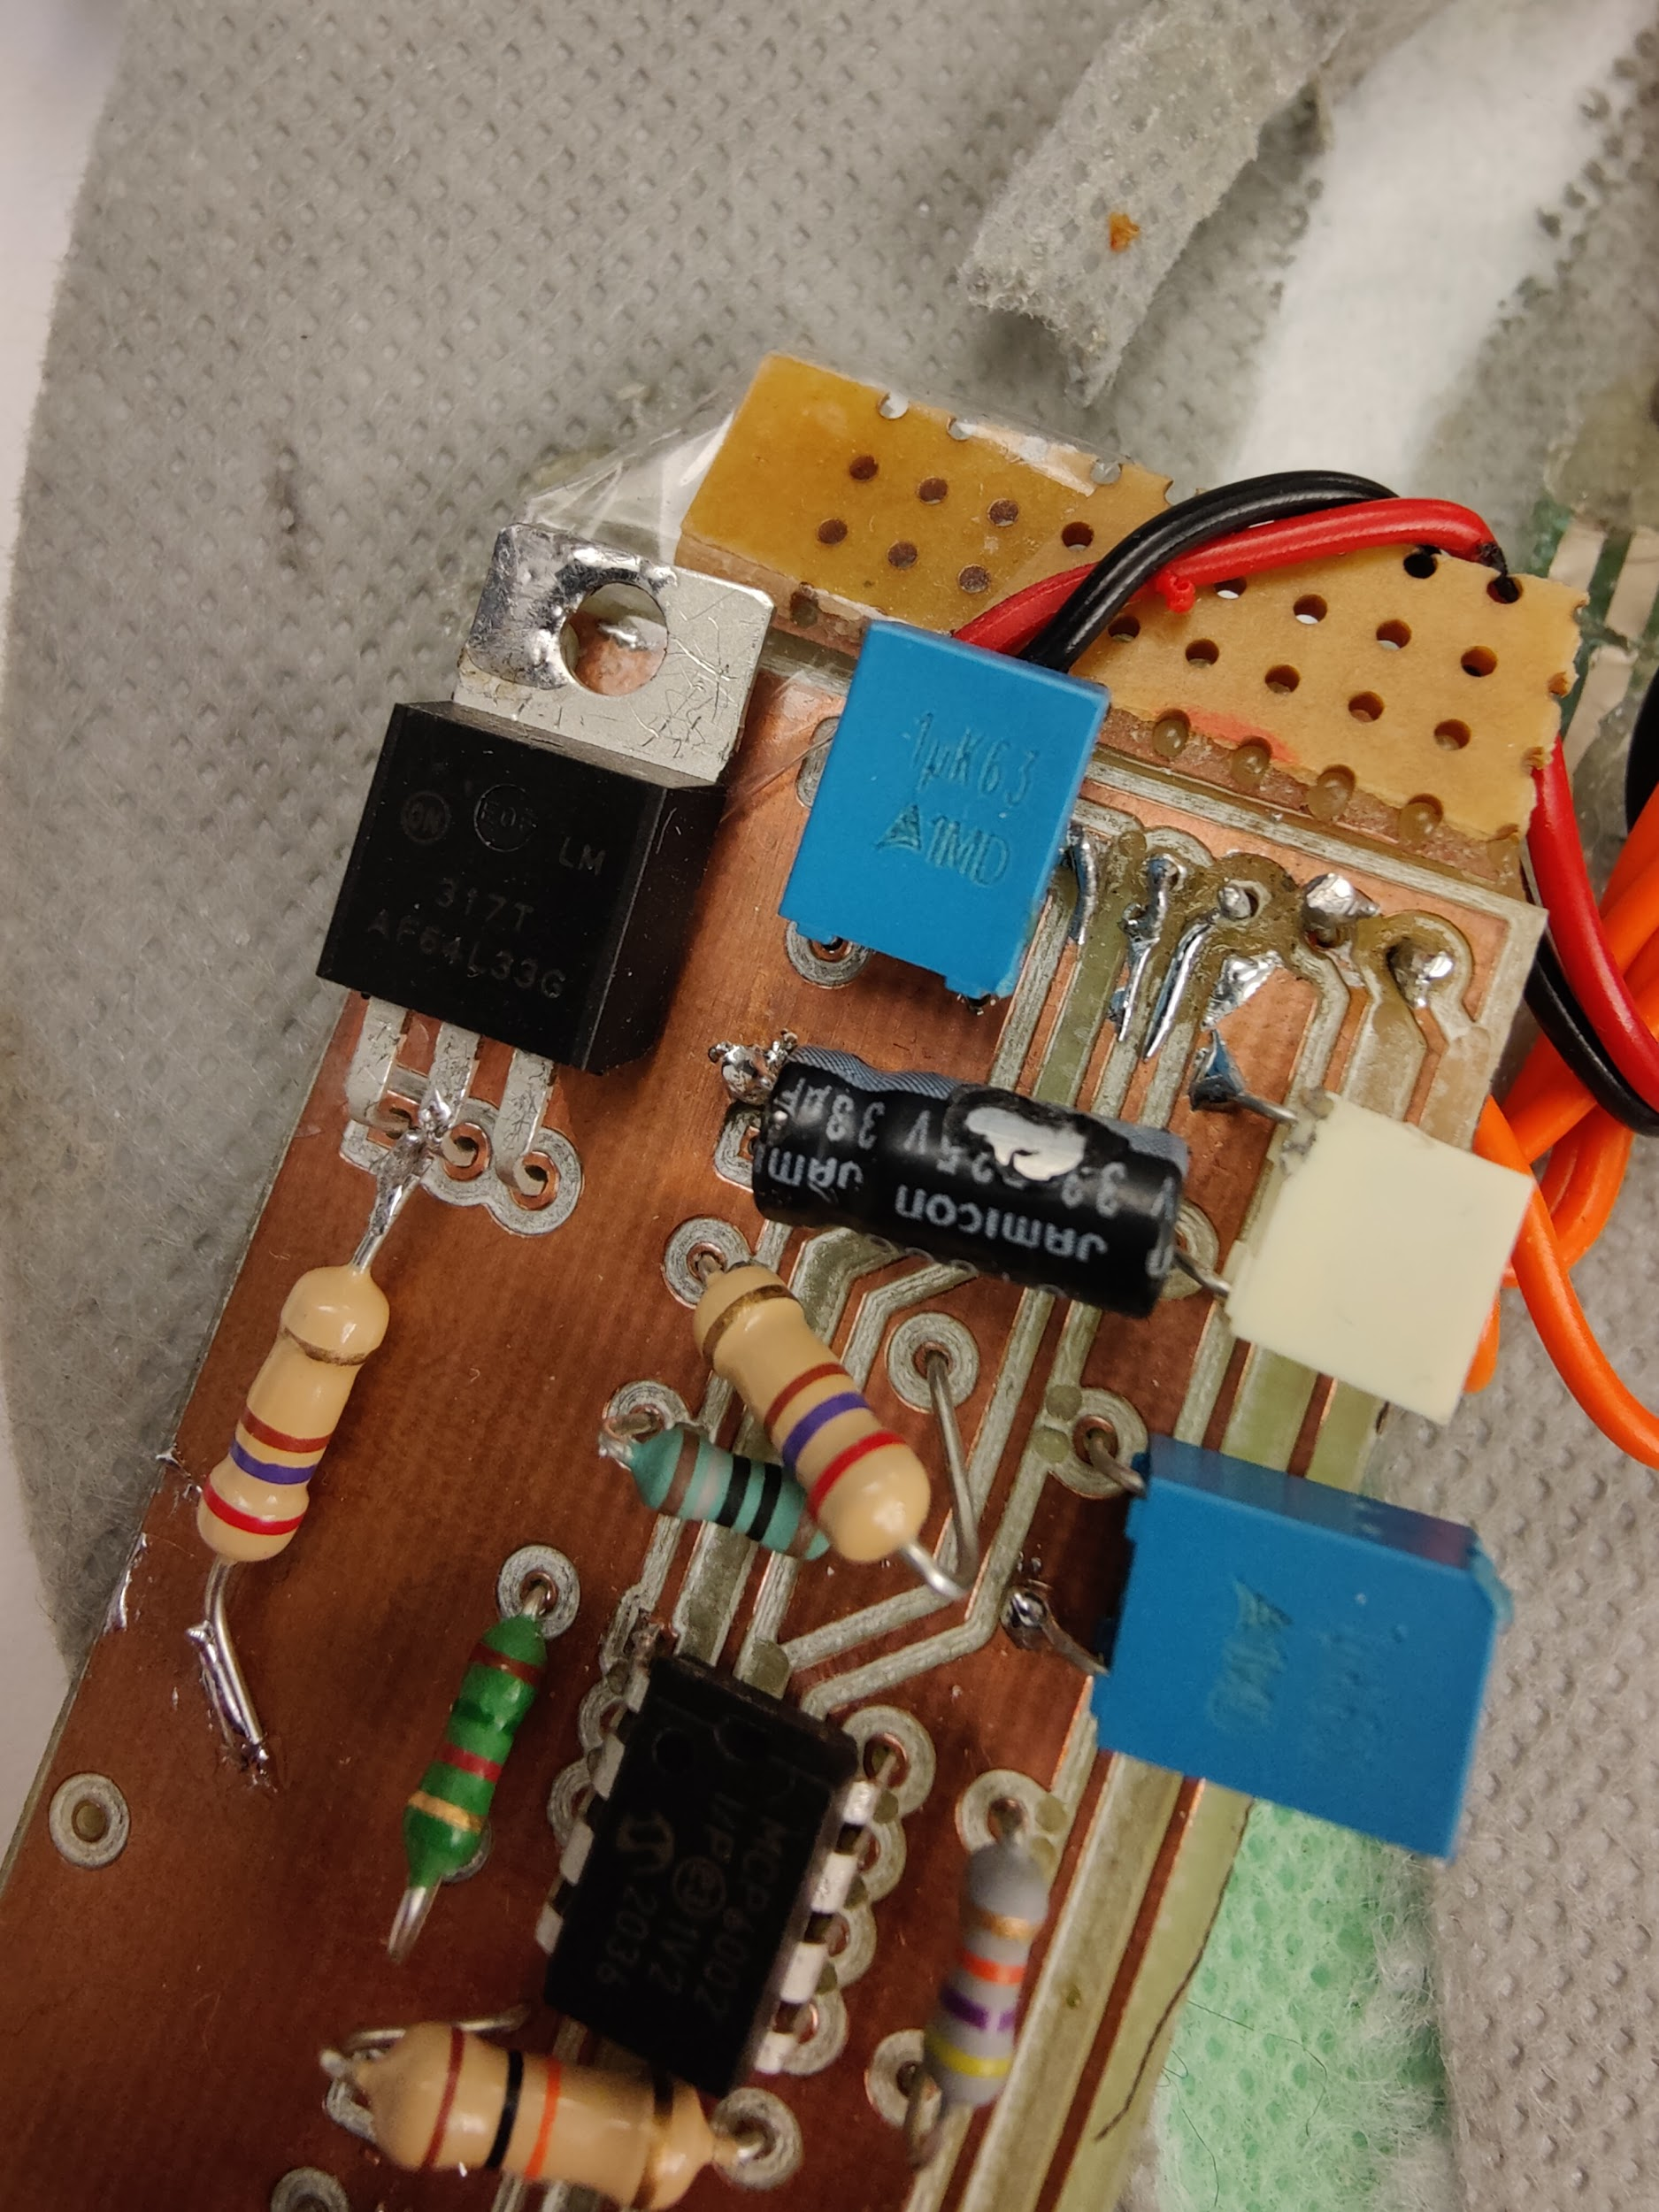
Aftermath
Shear and bending destroyed most things
4x FSR, 1 BLE module, 2 soles
Total destruction cost: ~400 kr

Slide 6
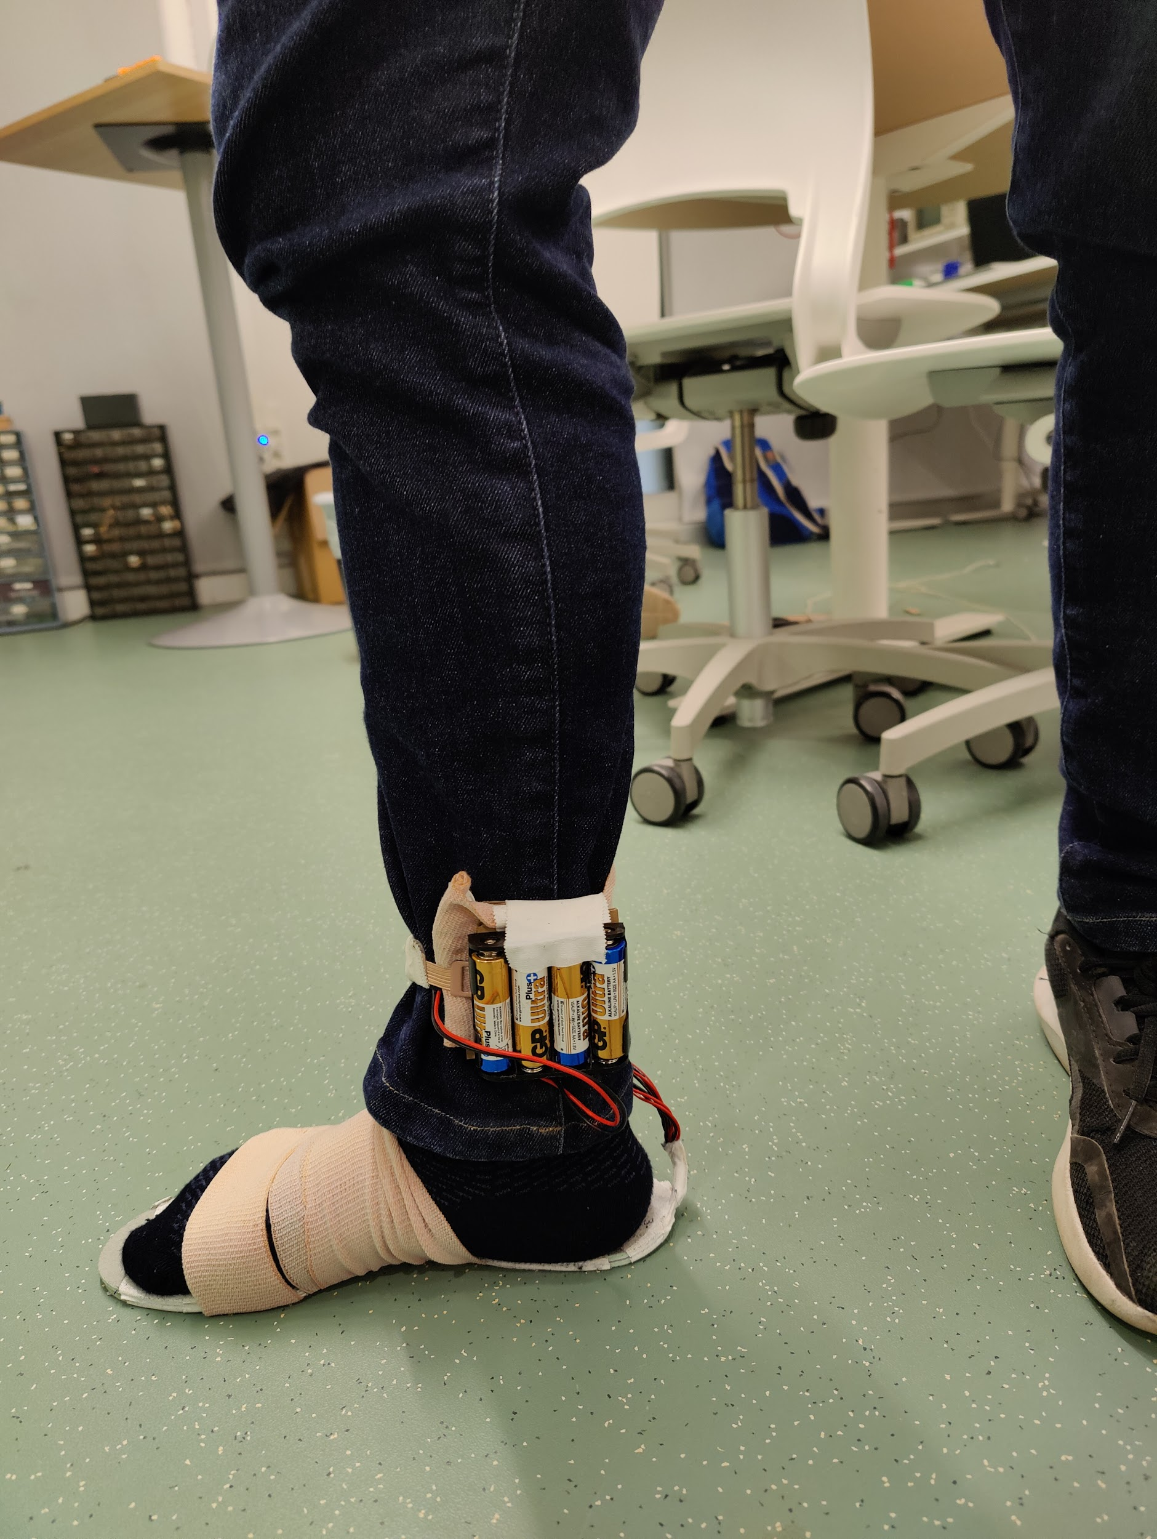
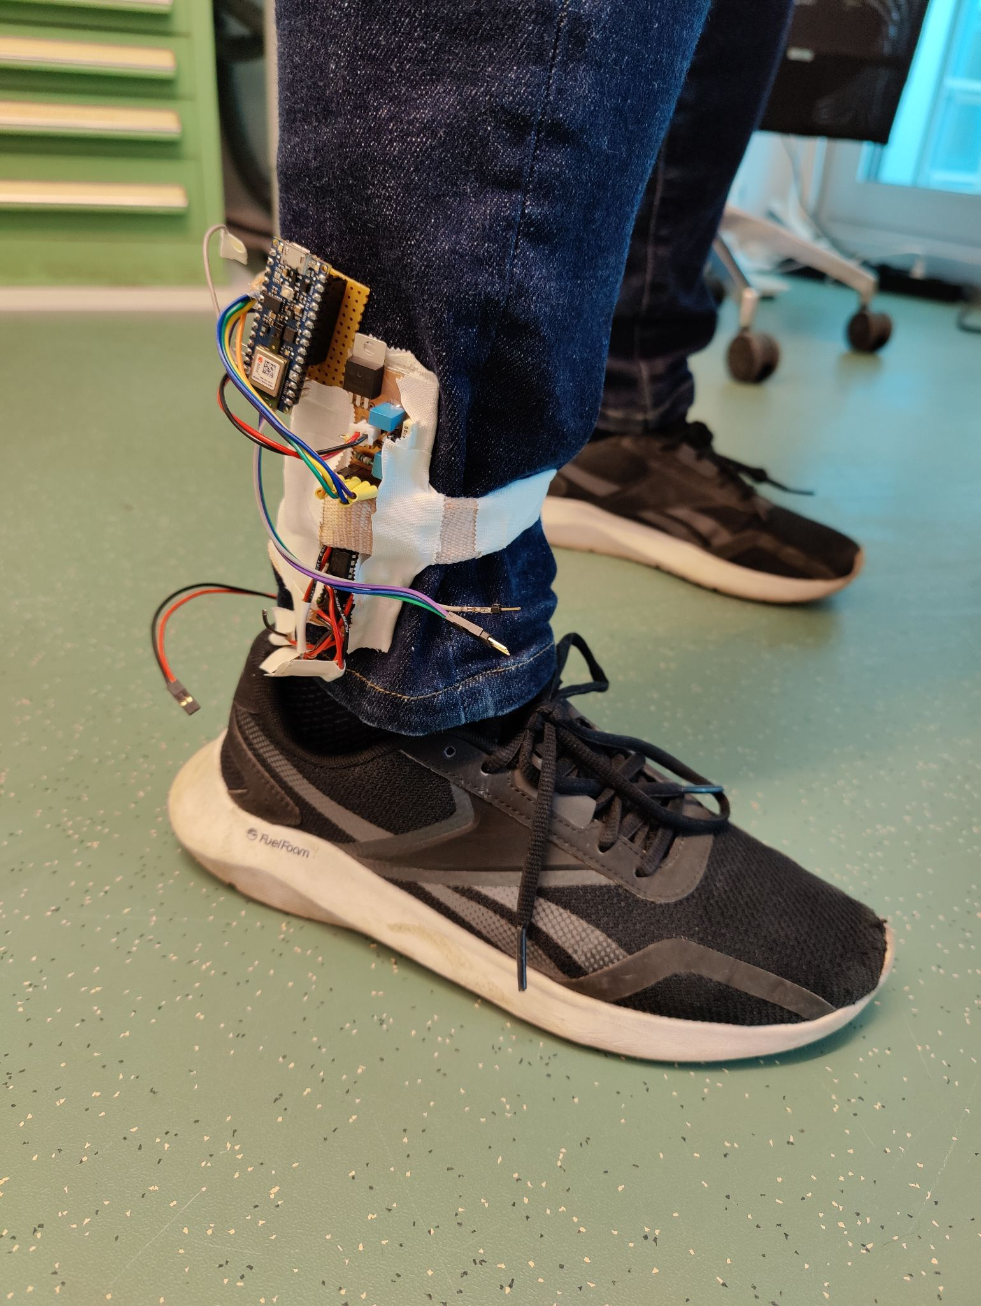
Prototype v2 - “Robust and Modular”
Updates:
Tweaked some resistors
Added connectors to take it off easy
Bigger traces, more hole clearance
Added battery + connector
Straps for security & maximum comfort!
Layering of sole to reduce shearing on FSRs
Repositioned FSRs to fit the person’s foot
Notes:
Reallocated wires as well to protect them

Slide 7
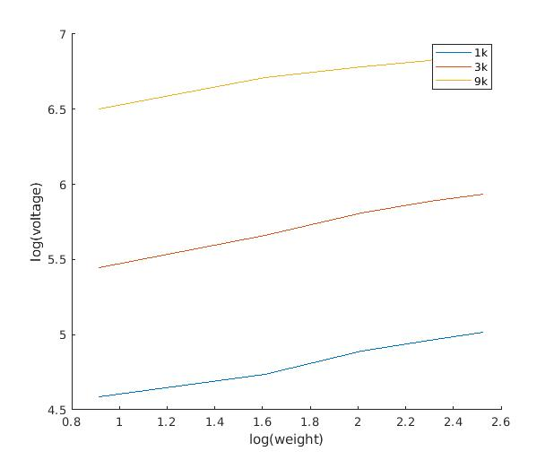
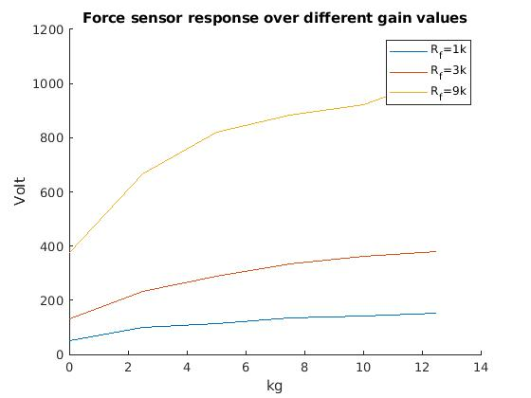
Force Sensitive Resistor - Weight calibration

Slide 8
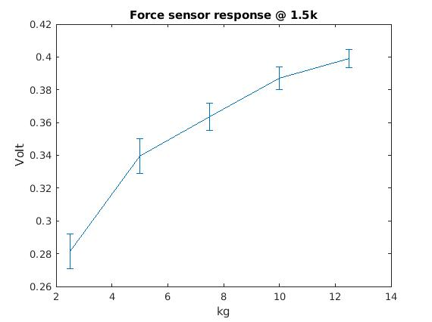
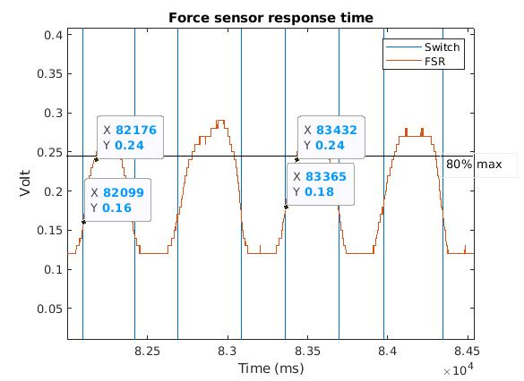
FSR - Response time and Repeatability
Response time ~60 - 70 ms
~ 6%
~ 70 ms

Slide 9
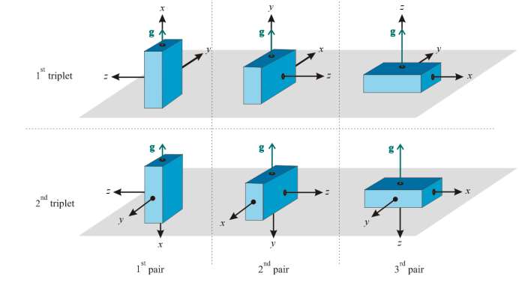
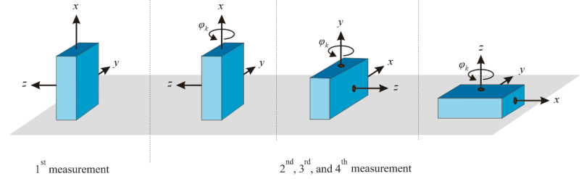
Evaluation - IMU data processing
Accelerometer and Gyroscope Calibration
Need to compensate sensor inaccuracies:
zero level offset
scaling
misalignment
→ Stančin and Tomažič refinement
q = C_{s}(q_{s}- q_{o})
Sensors | Free Full-Text | Time- and Computation-Efficient Calibration of MEMS 3D Accelerometers and Gyroscopes (mdpi.com)
Notes:
Cs is a 3 × 3 calibration matrix
qs is a vector of the values detected by the 3D sensor
qo is a zero level offset vector
q is the vector of the values after the calibration

Slide 10
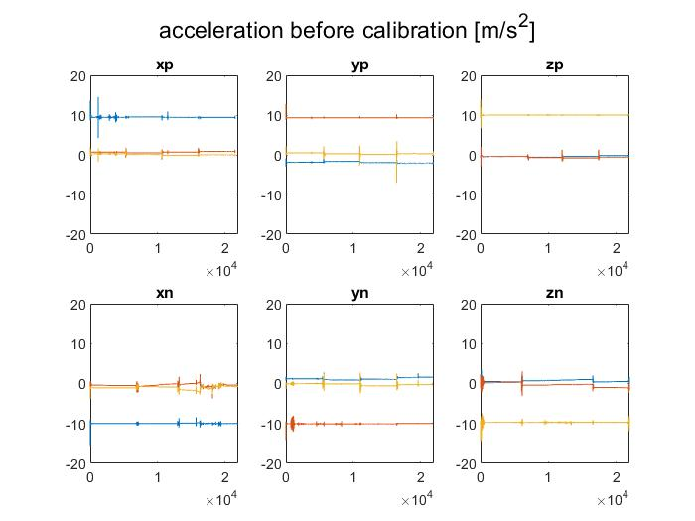
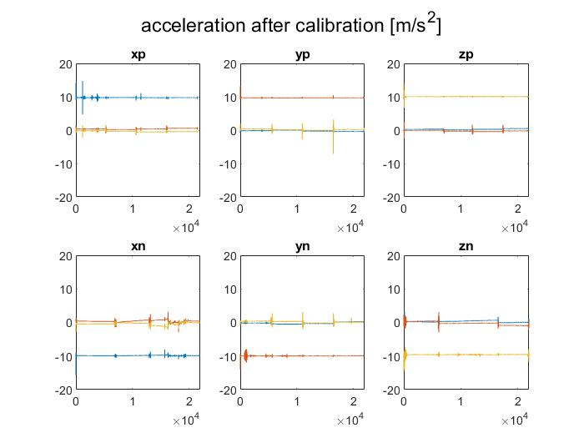
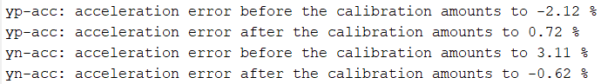
IMU - Calibration
Accelerometer Calibration
After calibration the values are closer to the ideal values ​​of gravity (9.81 m/s²) and 0 m/s².
Deviations from the ideal values before calibration

Slide 11
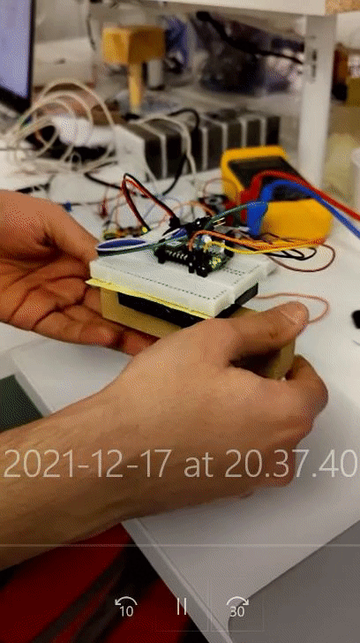
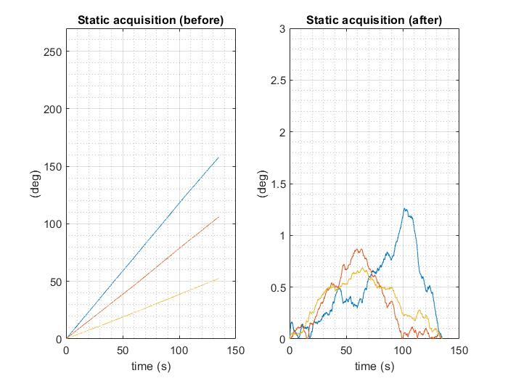
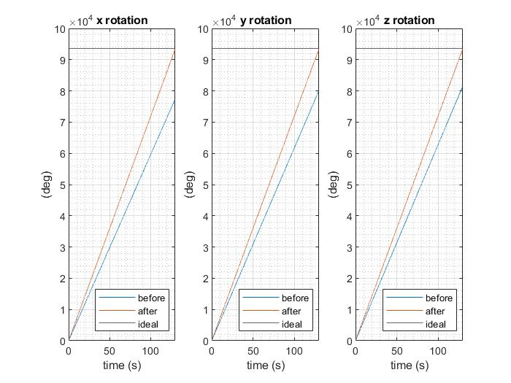
IMU - Calibration
Gyroscope Calibration
The bias increases over time
The error is reduced until it disappears during the acquisitions
Before: final angle value is less than the ideal value 93,600° (360° x 260 cycles)
After: the final angle is much closer to the ideal one.

Slide 12
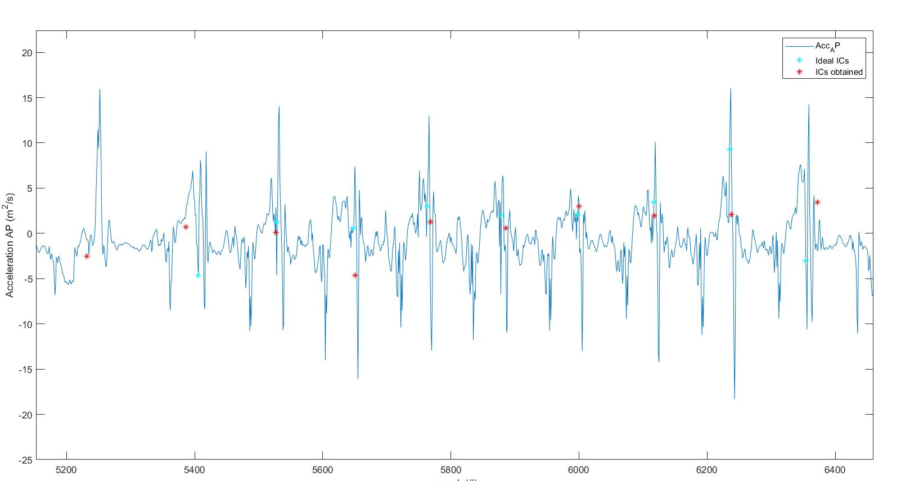
Evaluation - IMU data processing
Temporal parameters
→ Trojanello method:
Identification of Trusted Swing and Trusted Stance intervals
Identification of “search intervals”
Estimation of Initial and Final Contacts (ICs and FCs)
Used to calculate:
Stride Time
Stance Time
Swing Time
Notes:
“TSW was identified by isolating the time interval during which the gyroscope signal along the z direction (z) exceeded the 20% of its maximum value. TST was obtained by isolating, at the center of the portion of the gait cycle outside the TSW interval (^TSW), the time interval in which z showed a standard deviation 60% lower than that in ^TSW. Therefore, TIC and TFC were defined as the time intervals between TSW and TST and TST and TSW, respectively. The tIC was identified as the instant of minimum z in the time interval between the beginning of TIC and the instant of maximum anterior acceleration ay in TIC. The instant tFC was defined as the occurrence of the minimum of ay preceding the instant of the last maximum value in TFC” → Trojanello
(PDF) • D. Trojaniello , A. Cereatti, G. Paolini, A. Ravaschio U. Della Croce , “Temporal gait parameters determination from shank-worn mimu signals recorded during healthy and pathological gait”, Proc. . XXIV International Congress Biomechanics (ISB), Natal, Brasile, 2013 (researchgate.net)
“the FC search interval was made to begin at the minimum Z angular velocity rather than the maximum Y acceleration, being the former easier to identify” → Bertoli
(PDF) Estimation of spatio-temporal parameters of gait from magneto-inertial measurement units: Multicenter validation among Parkinson, mildly cognitively impaired and healthy older adults (researchgate.net)

Slide 13
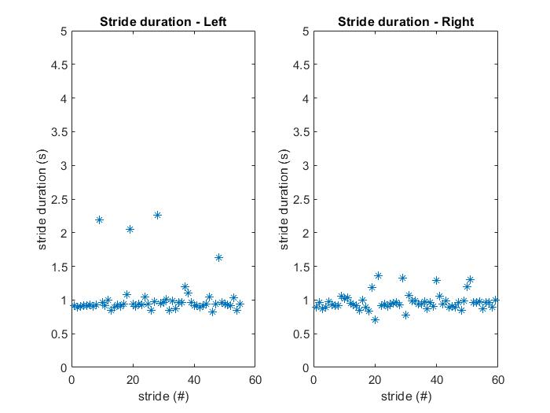
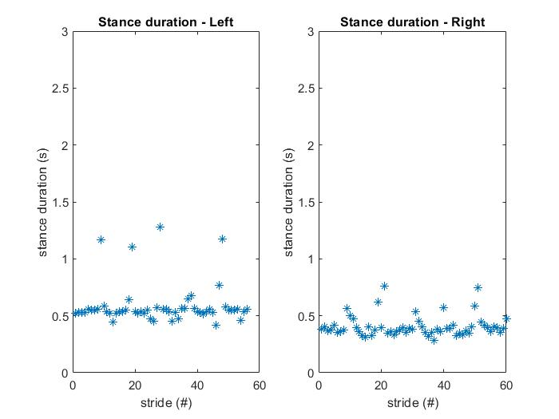
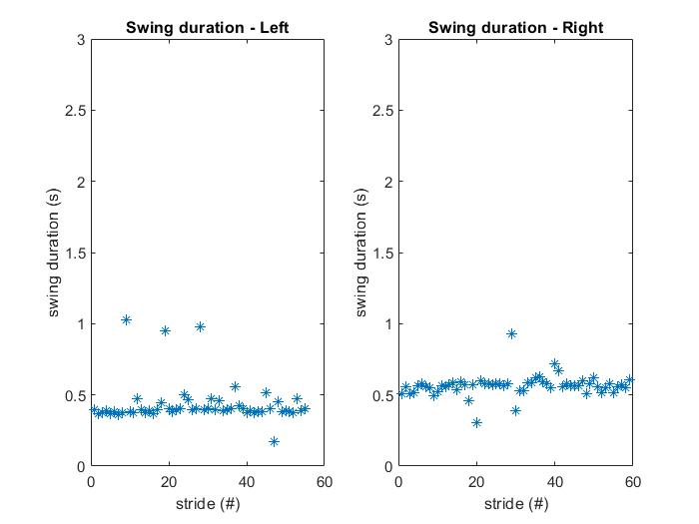
Evaluation - IMU data processing
Temporal parameters: outcomes
Stride Time
Stance Time
Swing Time
Notes:
“TSW was identified by isolating the time interval during which the gyroscope signal along the z direction (z) exceeded the 20% of its maximum value. TST was obtained by isolating, at the center of the portion of the gait cycle outside the TSW interval (^TSW), the time interval in which z showed a standard deviation 60% lower than that in ^TSW. Therefore, TIC and TFC were defined as the time intervals between TSW and TST and TST and TSW, respectively. The tIC was identified as the instant of minimum z in the time interval between the beginning of TIC and the instant of maximum anterior acceleration ay in TIC. The instant tFC was defined as the occurrence of the minimum of ay preceding the instant of the last maximum value in TFC” → Trojanello
(PDF) • D. Trojaniello , A. Cereatti, G. Paolini, A. Ravaschio U. Della Croce , “Temporal gait parameters determination from shank-worn mimu signals recorded during healthy and pathological gait”, Proc. . XXIV International Congress Biomechanics (ISB), Natal, Brasile, 2013 (researchgate.net)
“the FC search interval was made to begin at the minimum Z angular velocity rather than the maximum Y acceleration, being the former easier to identify” → Bertoli
(PDF) Estimation of spatio-temporal parameters of gait from magneto-inertial measurement units: Multicenter validation among Parkinson, mildly cognitively impaired and healthy older adults (researchgate.net)

Slide 14
Evaluation - IMU data processing
Spatial parameters
→ TEADRIP method:
Identification of the instants of integration (mid-stance)
Removal of gravity
Inverse pendulum model
Removal of the mean value acceleration
Reorientation of accelerations along the DoP
Direct and reverse integration for speed estimation
Simple integration for displacement estimation
Used to calculate:
Stride length
Stride velocity
Notes:
TEADRIP = Trusted Events and Acceleration Direct and Reverse Integration along the direction of Progression
DoP = Direction of Progression
“The stride length was estimated as the distance traversed by the MIMU between two consecutive ICs of the same foot. To estimate it, the proper acceleration signals were first expressed in the GCS, then gravity was removed. For each gait cycle analyzed, a specific motor task coordinate system (MTCS) was defined ; the vertical axis (V) was made to coincide with the gravity direction whereas the anterior-posterior (AP) axis was made to coincide with the direction of progression, which was determined as the direction of maximum average velocity obtained by integrating the horizontal acceleration components using the Optimally Filtered Direct and Reverse Integration (OFDRI) technique. while the ML axis was defined as the direction orthogonal to the AP axis. For each gait cycle, the AP acceleration component expressed in the MTCS was integrated using the OFDRI [37] from the 40% of the stance phase when at least a selected point of the foot (the calcaneous) can be considered fixed with respect to the ground [47]. The OFDRI technique requires the knowledge of the final value of the integral to set a cut off frequency for the high pass filter employed to reduce the effect of the drift in the accelerometer signals. The resulting cut-off frequency was then applied for filtering the acceleration signals in the MTCS, one gait cycle at a time. The initial integration value for the linear AP velocity of the MIMU was determined as the product of ML angular velocity and the MIMU distance from the calcaneous. The velocity values found for the final instant of the gait cycle were used as initial velocity values for the integration of the following gait cycle. Finally, the stride length was obtained as the AP displacement resulting from a further simple integration of the AP velocity previously obtained.“
Estimation of step-by-step spatio-temporal parameters of normal and impaired gait using shank-mounted magneto-inertial sensors: application to elderly, hemiparetic, parkinsonian and choreic gait (nih.gov)

Slide 15
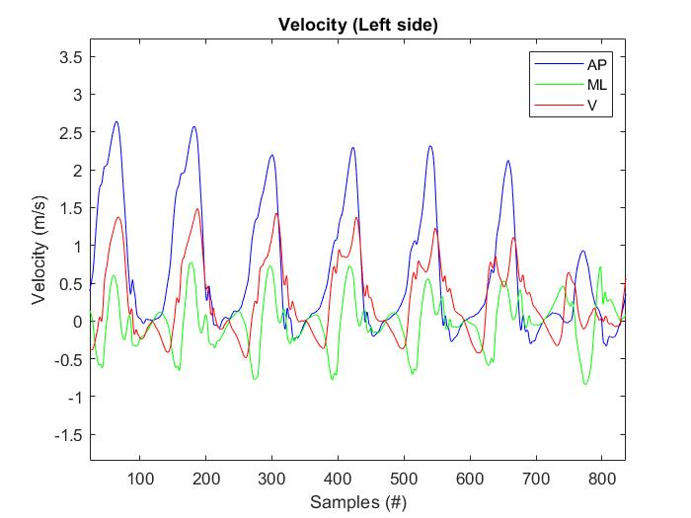
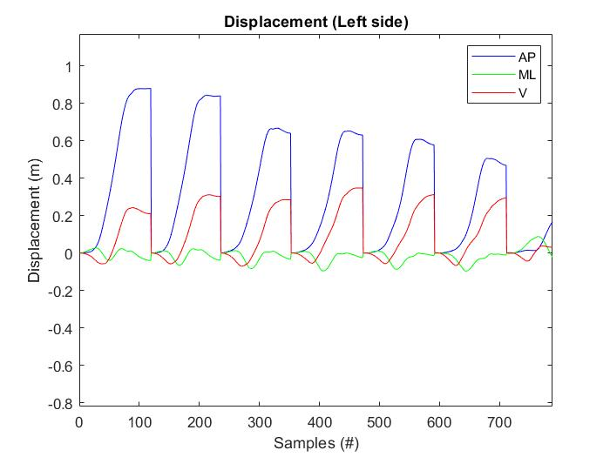
Evaluation - IMU data processing
Spatial parameters: outcomes
Notes:
TEADRIP = Trusted Events and Acceleration Direct and Reverse Integration along the direction of Progression
DoP = Direction of Progression
“The stride length was estimated as the distance traversed by the MIMU between two consecutive ICs of the same foot. To estimate it, the proper acceleration signals were first expressed in the GCS, then gravity was removed. For each gait cycle analyzed, a specific motor task coordinate system (MTCS) was defined ; the vertical axis (V) was made to coincide with the gravity direction whereas the anterior-posterior (AP) axis was made to coincide with the direction of progression, which was determined as the direction of maximum average velocity obtained by integrating the horizontal acceleration components using the Optimally Filtered Direct and Reverse Integration (OFDRI) technique. while the ML axis was defined as the direction orthogonal to the AP axis. For each gait cycle, the AP acceleration component expressed in the MTCS was integrated using the OFDRI [37] from the 40% of the stance phase when at least a selected point of the foot (the calcaneous) can be considered fixed with respect to the ground [47]. The OFDRI technique requires the knowledge of the final value of the integral to set a cut off frequency for the high pass filter employed to reduce the effect of the drift in the accelerometer signals. The resulting cut-off frequency was then applied for filtering the acceleration signals in the MTCS, one gait cycle at a time. The initial integration value for the linear AP velocity of the MIMU was determined as the product of ML angular velocity and the MIMU distance from the calcaneous. The velocity values found for the final instant of the gait cycle were used as initial velocity values for the integration of the following gait cycle. Finally, the stride length was obtained as the AP displacement resulting from a further simple integration of the AP velocity previously obtained.“
Estimation of step-by-step spatio-temporal parameters of normal and impaired gait using shank-mounted magneto-inertial sensors: application to elderly, hemiparetic, parkinsonian and choreic gait (nih.gov)

Slide 16
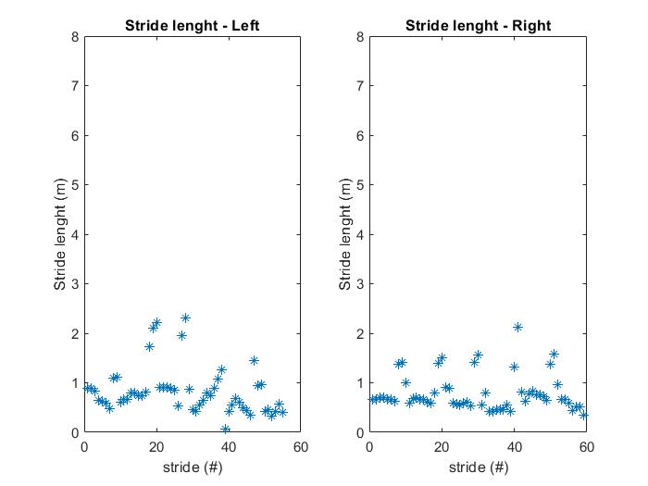
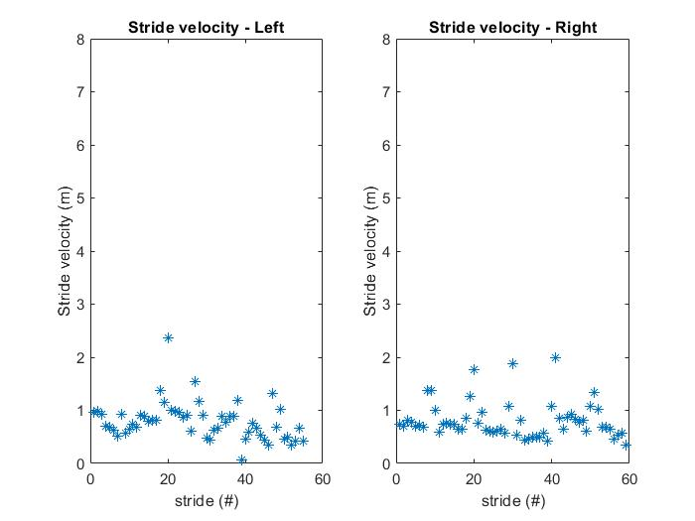
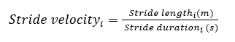
Evaluation - IMU data processing
Spatial parameters: outcomes
Notes:
TEADRIP = Trusted Events and Acceleration Direct and Reverse Integration along the direction of Progression
DoP = Direction of Progression
“The stride length was estimated as the distance traversed by the MIMU between two consecutive ICs of the same foot. To estimate it, the proper acceleration signals were first expressed in the GCS, then gravity was removed. For each gait cycle analyzed, a specific motor task coordinate system (MTCS) was defined ; the vertical axis (V) was made to coincide with the gravity direction whereas the anterior-posterior (AP) axis was made to coincide with the direction of progression, which was determined as the direction of maximum average velocity obtained by integrating the horizontal acceleration components using the Optimally Filtered Direct and Reverse Integration (OFDRI) technique. while the ML axis was defined as the direction orthogonal to the AP axis. For each gait cycle, the AP acceleration component expressed in the MTCS was integrated using the OFDRI [37] from the 40% of the stance phase when at least a selected point of the foot (the calcaneous) can be considered fixed with respect to the ground [47]. The OFDRI technique requires the knowledge of the final value of the integral to set a cut off frequency for the high pass filter employed to reduce the effect of the drift in the accelerometer signals. The resulting cut-off frequency was then applied for filtering the acceleration signals in the MTCS, one gait cycle at a time. The initial integration value for the linear AP velocity of the MIMU was determined as the product of ML angular velocity and the MIMU distance from the calcaneous. The velocity values found for the final instant of the gait cycle were used as initial velocity values for the integration of the following gait cycle. Finally, the stride length was obtained as the AP displacement resulting from a further simple integration of the AP velocity previously obtained.“
Estimation of step-by-step spatio-temporal parameters of normal and impaired gait using shank-mounted magneto-inertial sensors: application to elderly, hemiparetic, parkinsonian and choreic gait (nih.gov)

Slide 17
Communication system
Tried using BLE to send the data on to a PC running MATLAB
Initially used different services for each parameter, but this was too slow due to BLE overhead. Solution was to use large packets.
Started with 8160 bytes a second, after some tradeoff and optimisation we brought it down to 3000. Ran into a bunch of issues with packed being lost / duplicates.
Found out very late that MATLAB had some support issues for large packets, so we didn’t have time to setup an SD card or similar for logging.
Finally, we logged the data over USB and processed the data offline

Slide 18

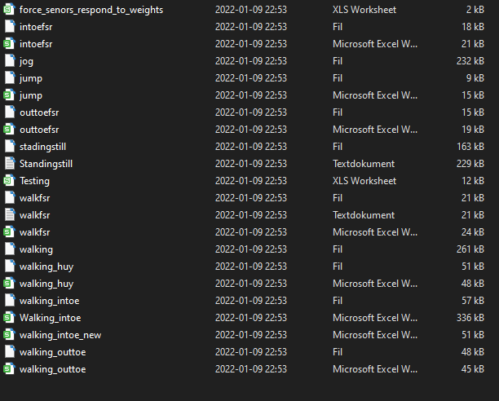
How to collect data: a guide

Slide 19
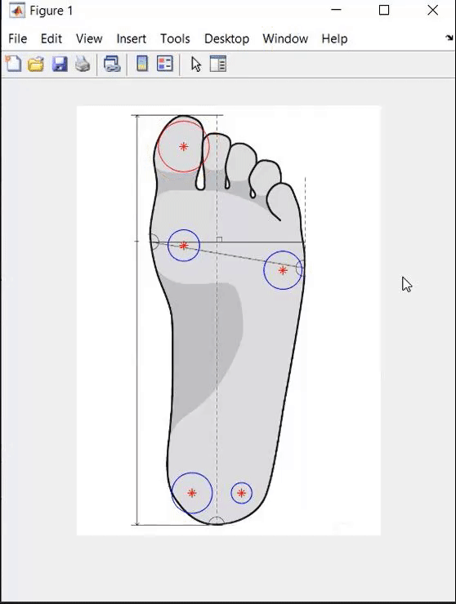
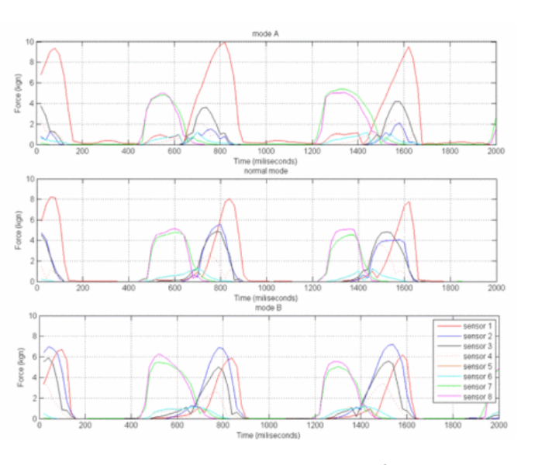
Pressure data processing
Gait phase visualization through collected data: walking
Weight distributions
Transverse force distributions
Gait phases
Response curve proportional to the force
Big circle = Big force
Red > Resting force
Blue < Resting force
Notes:
1st out toe
2nd normal
3rd in toe

Slide 20
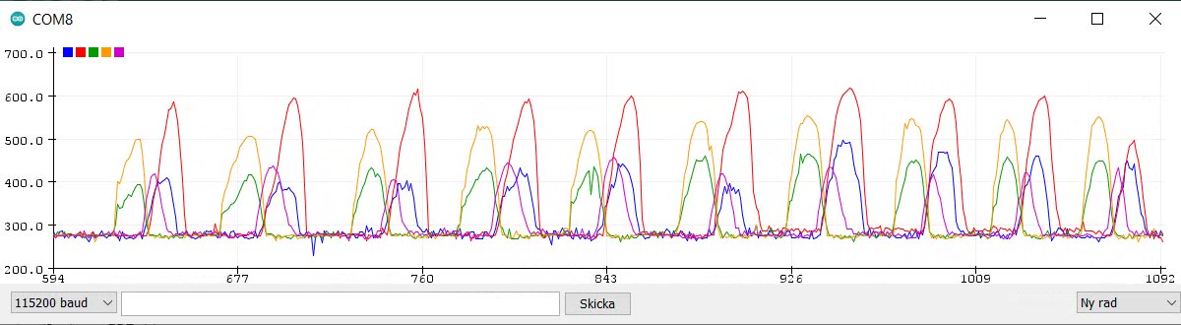
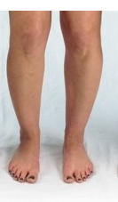
Walking cycles - Force sensor readings
Front inside Front outside Heel inside Heel outside Toe
Walking straight footed

Slide 21
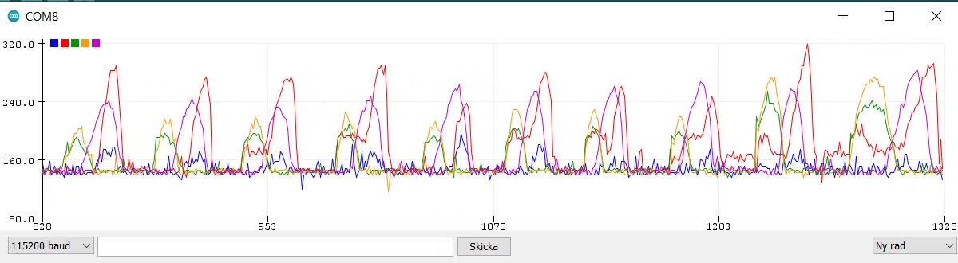
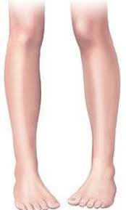
In-toeing
Front inside Front outside Heel inside Heel outside Toe
Notes:
In-toe walking can sometimes be seen in children who have feet that are curved inwards (pigeon toes). This can also be due to 'moulding' during pregnancy. It is often seen in children who tend to sleep face down.
More than 80 percent of children grow out of this by the age of 3-4 years.
If the foot is supple and flexible (the doctor will check that) treatment is not necessary. In some children with more pronounced problems and feet that are less flexible, the doctor may recommend special shoes, splints to be worn at night or, rarely, treatment with plaster casts.

Slide 22
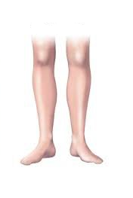
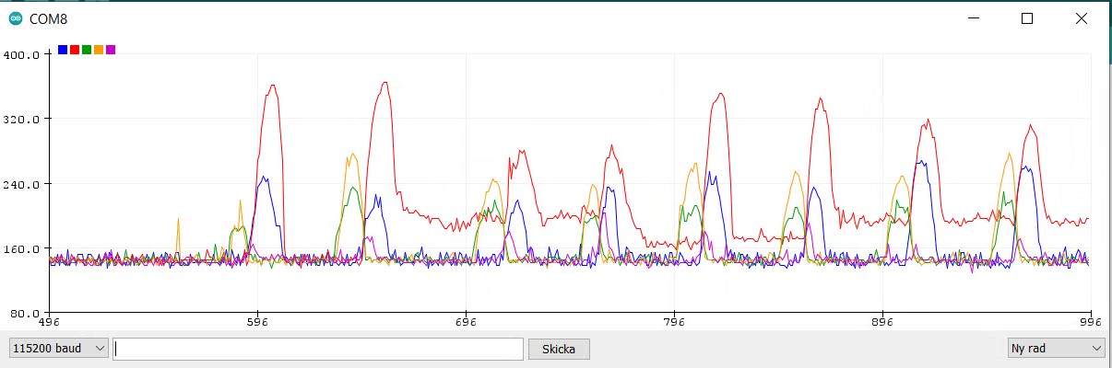
Out-toeing
Front inside Front outside Heel inside Heel outside Toe
Notes:
Opposite of in toe. While its normal for adults to walk with slightly outward feet. Having it really far out suggest injury to the leg, hip, ankle, or foot, muscle tightness in the legs or hips, poor posture

Slide 23

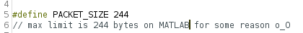
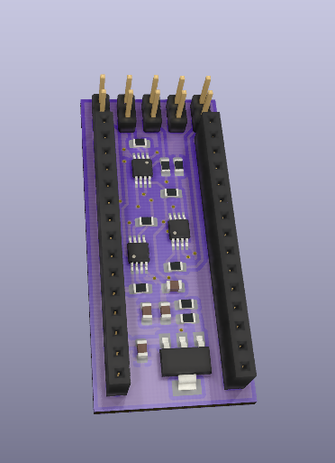
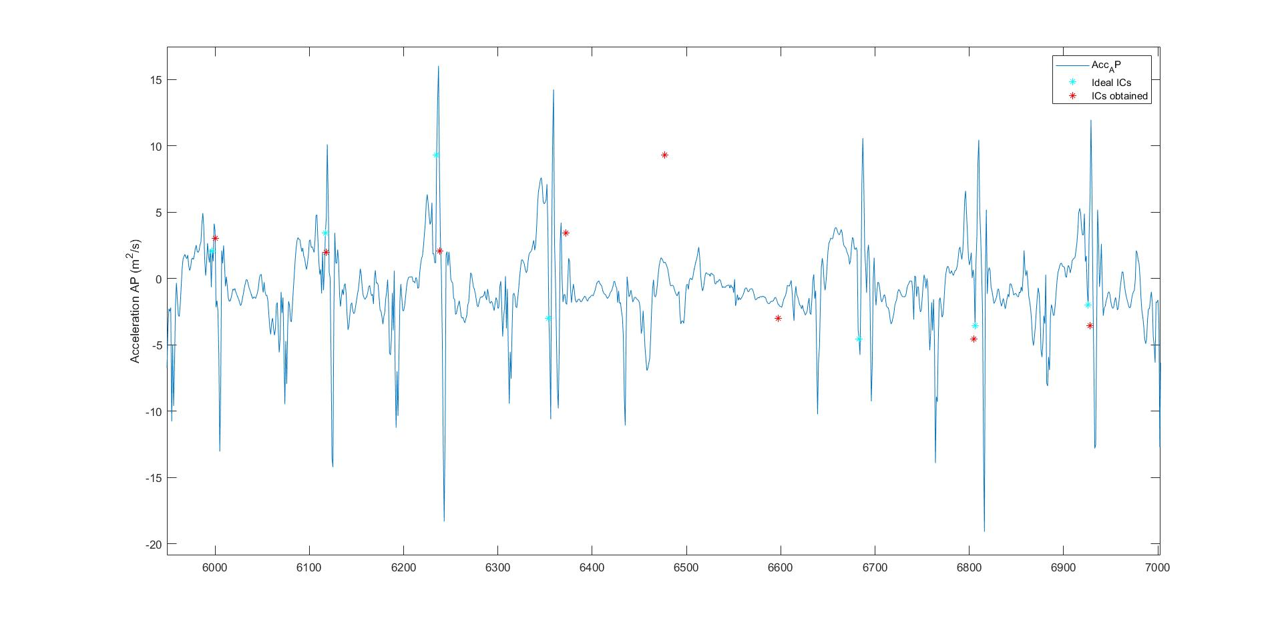
Discussion and future directions
Lessons learned:
Nuances in PCB designing and assembling
BLE limitations & software support in Matlab, Python
Data output formats
Future prospects:
Additional force sensors
Replace Nano with individual units to make PCB even smaller
Real time data processing and visualization in app
Alternative communication methods (4G,Wifi etc.)
Better IMU calibration
Improving ICs/FCs estimation code
???

Slide 24

Thank you!
Hardi Hamshin
Federica Carmen Maruccio
Mahyar Mehr
Rohit Rathnam Nareshkumar
Phuong Huy Nguyen
Checkout our GitHub project!

